Slide 1
BIOMEDIN 215 Data Science in Medicine
Nigam Shah, MBBS, PhD
nigam@stanford.edu

Slide 2




The teaching team
Nigam Shah – Course Instructor
Guest lecture: Mike Baiocchi
Suhana Bedi
Sohaib Hassan
Yixing Jiang
Joshua Lazaro

Slide 3
We use data from patient timelines …
Make a forecast
Pt.
Disease codes
Medication
Procedures
Imaging
Billing (claims)
Streaming data
Genome
Automate a task
Notes:
Feature-set completeness = Function (number, density, utility and resolution)

Slide 4
Lectures 1, 2
Where and why are data generated?
Research questions and study designs

Slide 5
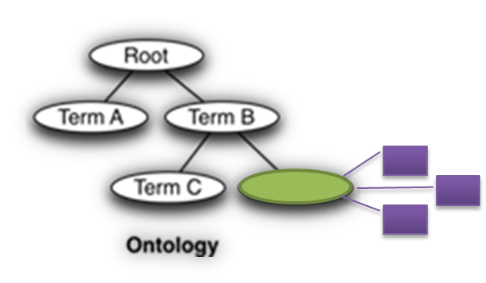
Lectures 3, 4
Ask about:
How are the data organized (i.e. what schema)?
Where do the data come from?
How can I access the data?
Where are the errors introduced?
Are the data useful for me? (exposures, outcomes, number of records)
Ask about:
Things
Names
Relationships

Slide 6
Lectures 5, 6
Transforming data into analysis ready datasets.
Feature spaces can be reduced using knowledge-graphs or via data-driven methods.
You can create new features from the raw data.
Missing data can be imputed with varying levels of sophistication (but be careful!).
Your effectiveness in doing these tasks will increase by knowing some biology and medicine.
Text is one source to mine
[be careful how deep you go!]
Notes:
How do you turn messy data into a dataset to analyze?
What is the impact of these methods on the answers we get to our clinical questions?

Slide 7
Lectures 7, 8
Data and questions span many timescales, with irregular time intervals
Ordering of events is crucial.
We can use time explicitly (time-series, time-to-outcome) or implicitly (binning)
Timing of exposures and outcomes is crucial. Get index time right.
Clinical processes are often nonstationary
Electronic Phenotyping = defining the necessary and sufficient conditions to accept that an exposure or outcome of interest occurred based on what you see in the patient timeline
Notes:
Stuff to worry about:
Repeated observations
Irregular time intervals
Large number of (sparse) features
Choices of binning
Choices of constructing features
The dimensions of electronic phenotyping: features, time, and definition complexity.
Think of: a feature dimension (i.e., what features are used to characterize a phenotype), a time dimension (does the representation support a time variant definition of the phenotype) and the definition complexity (how complex is the representation corresponding to a phenotype definition).

Slide 8
One slide summary of your tool-kit
The basics:
The anatomy of the healthcare system
The research questions and study designs
The sources of, and errors in, the data used
Using knowledge graph/s of things, their names, and relationships
The choices:
The source and choice of features
How much to agonize over textual data
On the handling of time
In defining an electronic phenotype

Slide 9
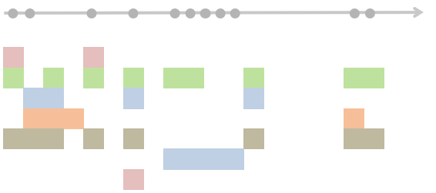
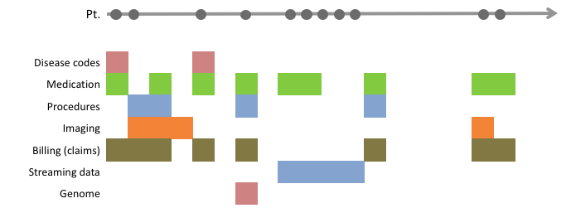
Analyzing timelines to answer questions
Whether to treat
How to treat
Logistic Regression
Random Forest
Deep Neural Network

Slide 10
Focus on finding the right questions
Science
Practice
Delivery
Classify
Finding subtypes of heart failure with preserved ejection fraction
Who might be at high risk for a thromboembolism?
Who is burnt out?
Predict
…
Which patients are likely to die in the next 3-12 months?
Who will be a no show?
model
Act/Treat
…
What is a good second line drug to manage diabetes after metformin?
Request four back up nurses on Wed, for the Ortho OR.
Notes:
Priorities differ for each stakeholder, which affects the data that are generated.
Design studies to leverage strengths of different data sources. Using multiple sources is beneficial.
Targeting studies to the intersections of two or more interests is impactful.

Slide 11
The rest of the class – how to not be wrong
L-10
L-18
L-12, 13
L-15,16,17
L-14

Slide 12
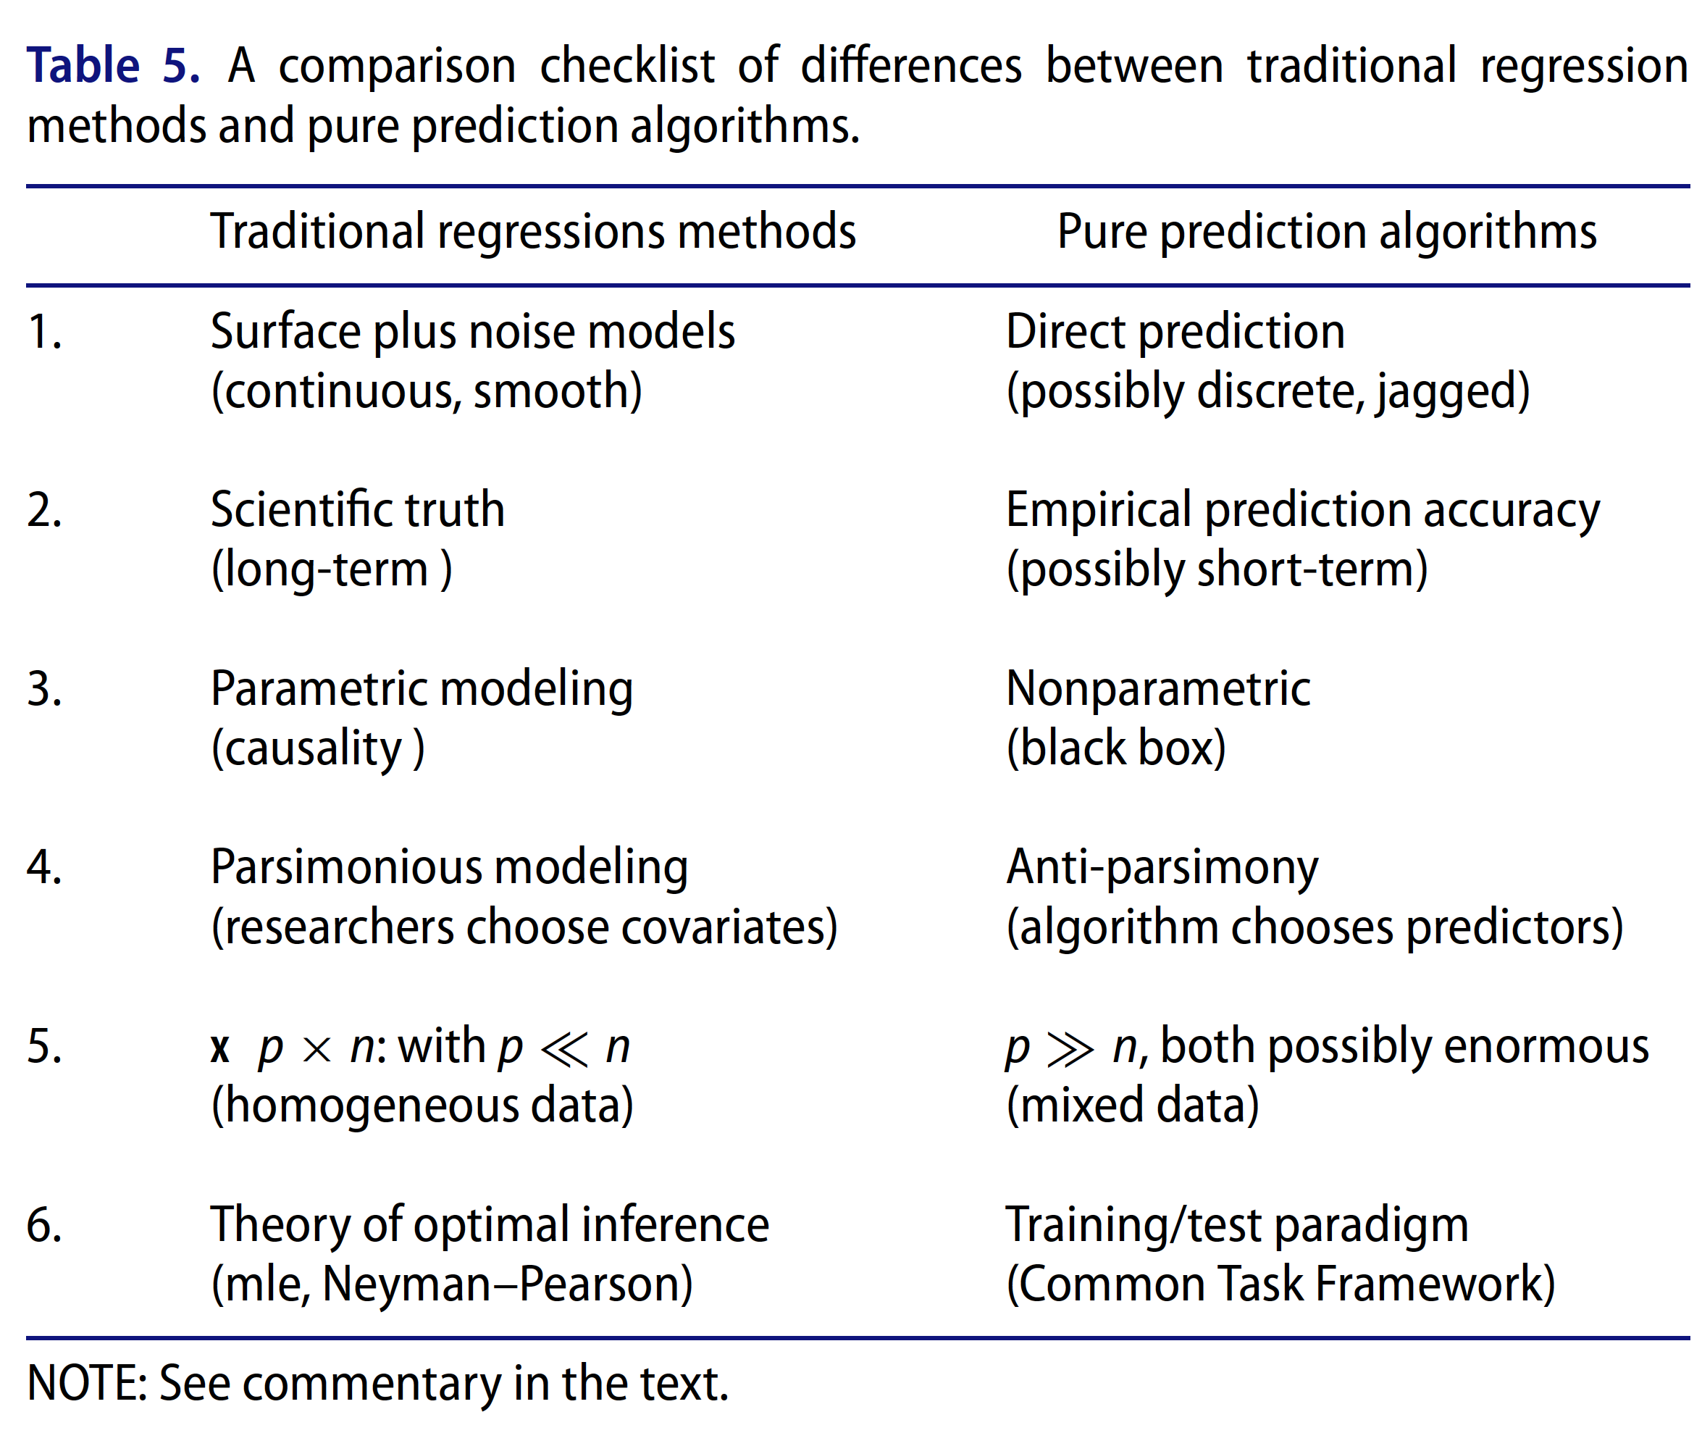
Recall: the two cultures

Slide 13
Inferential - data modeling
Aims to infer properties of a population given a smaller, observable sample
sampling
Data
x_{s} | y_{s}
0.12 | 12
… | …
19 | 1435
0.2 | 13
Data-generating process
inference
Notes:
Associative analysis methods (aka measures of association) enable comparison between groups to determine if the observed incidence or prevalence of an event is statistically significant, that is significantly different from what would be expected by chance if the event was not at all associated with the factors you’re investigating.
Attribute MedStats

Slide 14
Remember:
A statistical model is a set of assumptions about how the world works which defines a class of possible data-generating probability distributions
Model fitting is picking the distribution that’s most likely to have generated the data you see
Confidence intervals and hypothesis testing are ways to quantify variation in our estimate that comes from the randomness of sampling the data
Interpret findings in the context of the model

Slide 15
Evaluating inferential analyses
Size of the effect
Significance of effect
How likely is it to be true
How likely am I to be wrong
Remember:
The use of positive controls – associations you know to be true
The use of negative controls – associations you know to be false

Slide 16
Need to know:
What is the baseline risk?
Who will you include as the “not exposed”?
 |  | Outcome
 |  | + | -
Exposure | + | a | b
 | - | c | d
Include people with alternative indications
Include people on alternative Rx (or no Rx, most common Rx …)
Various ways of patient matching
Notes:
Based on the findings from mini-sentinel, OMOP efforts;
Bottom line was that choice of C, D cell matters more than choice of methods.

Slide 17
Predictive - algorithmic modeling
Aims to learn a good enough function given an observable sample (i.e. training data)
Notes:
We implicitly assume there is a real “data generating function”, which is unknown, that we are trying to create an approximation of

Slide 18
Remember:
All models (functions)
Search space: what are the possible models to consider? (a set of functions)
Loss function: given the data, how good do we consider each possible model? (a function of the model and the data)
Search strategy: how will we search the space of possible models to find the best one? (an algorithm)
search space
credit to Jerome Friedman (STATS 315B) for this framework

Slide 19
Evaluating predictive analyses
The use of calibration – quantifying how often are you correct at your stated confidence level
The use of precision recall curves – to understand the trade-offs of being wrong vs. missing a case
The data are changing under you – be aware of non-stationarity.
Notes:
There is no free lunch. No learning algorithm is better than another in all cases.
Performance largely depends on whether or not the model search space contains the true function that generated your particular dataset

Slide 20
Need to know: performance in the wild
Splitting our data into training and test sets lets us see how our model will perform in the wild

Slide 21
Lessons from the trenches

Slide 22




Regulation is a work in progress
The model -- the equation relating the inputs to output
The reliability (of the model) over time, sites, populations
Increase in quality of care by using the model to guide care
Increase in value of care by using the model to guide care
Software as a
medical device (SaMD)
As a digital, laboratory developed test (LDT)
Cert. as practice management software
Software as a therapeutic (DTx)
Notes:
The model (i.e. the equation relating the inputs to output) and its validity (over time, or across sites).
The betterment of care provided by using the model to guide care
Increase in value of care by using the model to guide care

Slide 23
Remember: Model, Intervention, Benefit
Useful, reliable and fair AI-guided care
The model and its output
Properties of the intervention
Policy and capacity to act
Generalizability (across sites)
Reliability (over time)
Explainability (Interpretability)
Fairness

Slide 24
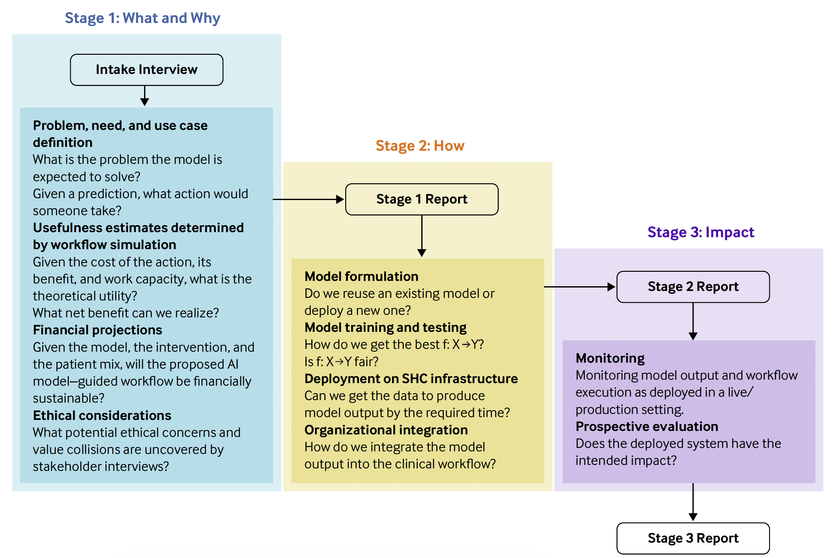
Fair, Useful, and Reliable Models

Slide 25
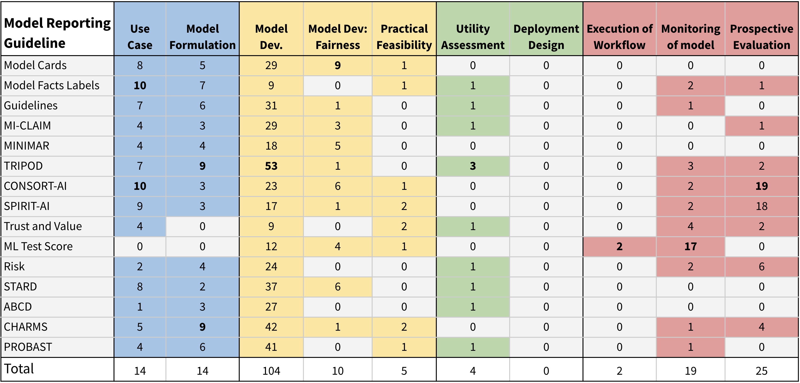
Too many: Thou shall …

Slide 26
Beware of ‘fairwashing’
Absence of systematic difference in the algorithm’s output for a certain class of individuals.
Absence of systematic difference in the accrual of benefits.
Fixing systematic different in the algorithm output is not enough to ensure equal accrual of benefit

Slide 27
Foundation models transcribe, summarize, or create in service of the science, practice or delivery of care
Science
Practice
Delivery
Transcribe
…
…
…
Summarize
…
…
…
Create
…
…
…

Slide 28
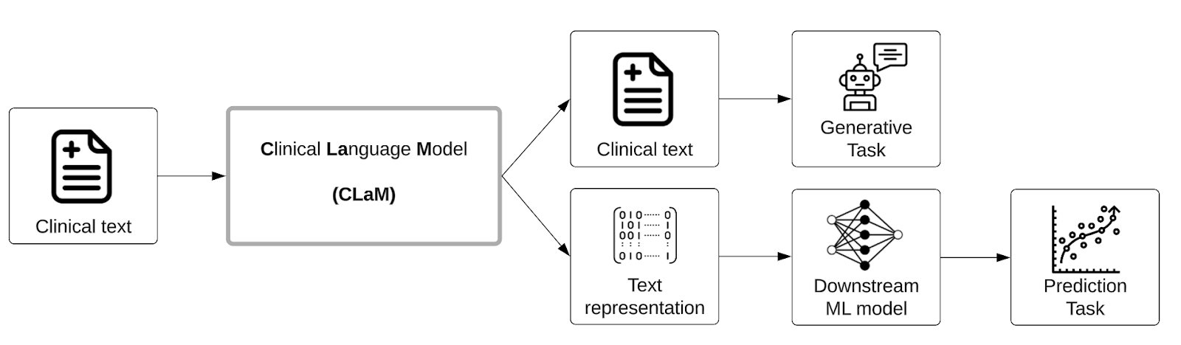
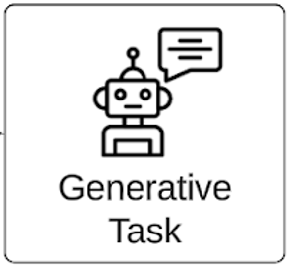
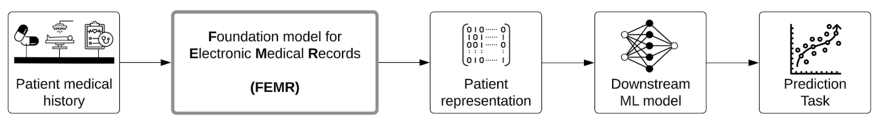
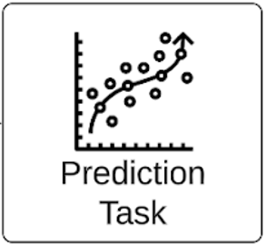
Two ways to build “language” models
“chat” and “summarization”
“documents”
“timelines”
Forecast what is going to happen
https://tinyurl.com/shaky-foundations

Slide 29
Remember: Verify benefits!
What is the data diet of the foundation model?
Are the inputs relevant to the intended use of the model; what biases, misinformation do the inputs have?
What data-processing, and pre-training were used?
Are the assumptions during pre-training compatible with your end use-case?
How and for what tasks is the foundation model evaluated?
Are the evaluations performed relevant for the intended use of the model?
What do the evaluation tasks tell us about the value proposition?
What evaluations can we do to confirm the possible benefits and value propositions?
How will you spot and rectify factual errors in the deployed system?
For a generative task, "hallucinations" are bound to happen. Plan on handling them!

Slide 30
Responsible AI in Health Systems
 | Readout | Standard AI | Generative AI
1. Discovery | technical feasibility and user acceptance | Too slow, too costly 10 years, $27.7M | Focus on “verifying benefits”!
2. Development | proof of meeting intent such as access, quality, or productivity gain | Focus on achievable benefit | ?
3. Dissemination | refine the technology as well as adapt the business model | ROI requires business model change | ?
Welcoming Innovation
http://goto.stanford.edu/innovation
We have a mature world-view here
http://furm.stanford.edu
We need to develop this world-view
Jindal et al, 2024 (JAMIA)
Notes:
https://www.healthaffairs.org/do/10.1377/forefront.20191119.155490/full/

Slide 31
Data Science can offer …
Precision in the Science of Medicine
Measure a zillion variables to figure out what is going on and why.
Precision in the Practice of Medicine
Let’s look at what we routinely collect on millions of individuals to make care better for the next person.
Precision in Delivery of Medical care.
People have priorities beyond just getting treated.

Slide 32
Learning Goals
1
Differentiate between and give examples of categories of research questions and the study designs used to address them
2
Describe common healthcare data sources and their relative advantages and limitations
3
Extract and transform various kinds of clinical data to create analysis-ready datasets
4
Design and execute an analysis of a clinical dataset based on your familiarity with the workings, applicability, and limitations of common statistical methods
Leverage your knowledge of 1-4 to evaluate and critique published research
5

Slide 33
Tell us what you think!
You just completed the class. Please tell us how it went. Were the learning goals met? What would you want changed?
Please take a few minutes and fill out the course evaluations. It’s anonymous, so please be candid; and if you can, tell us your ideas of how to fix what you didn’t like.

